Slide 1
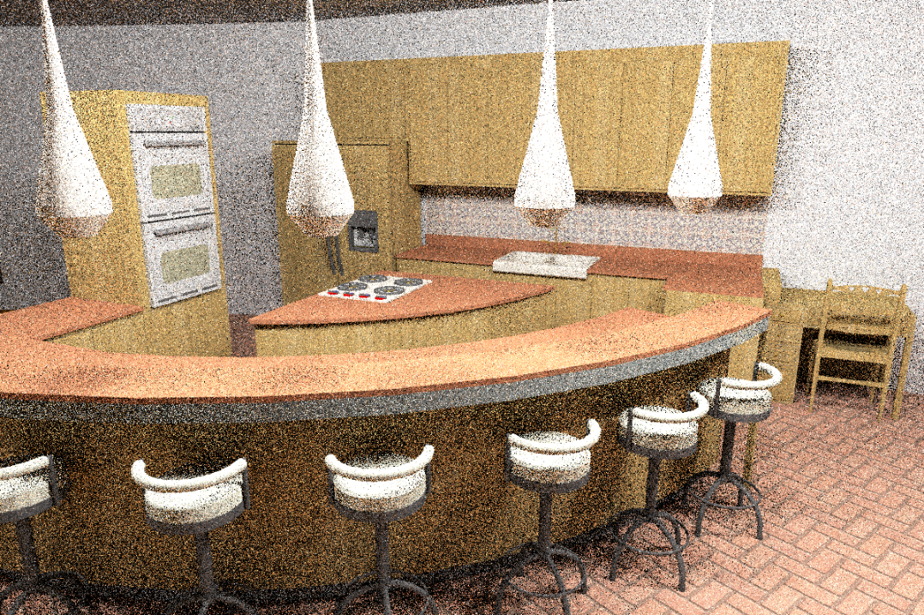
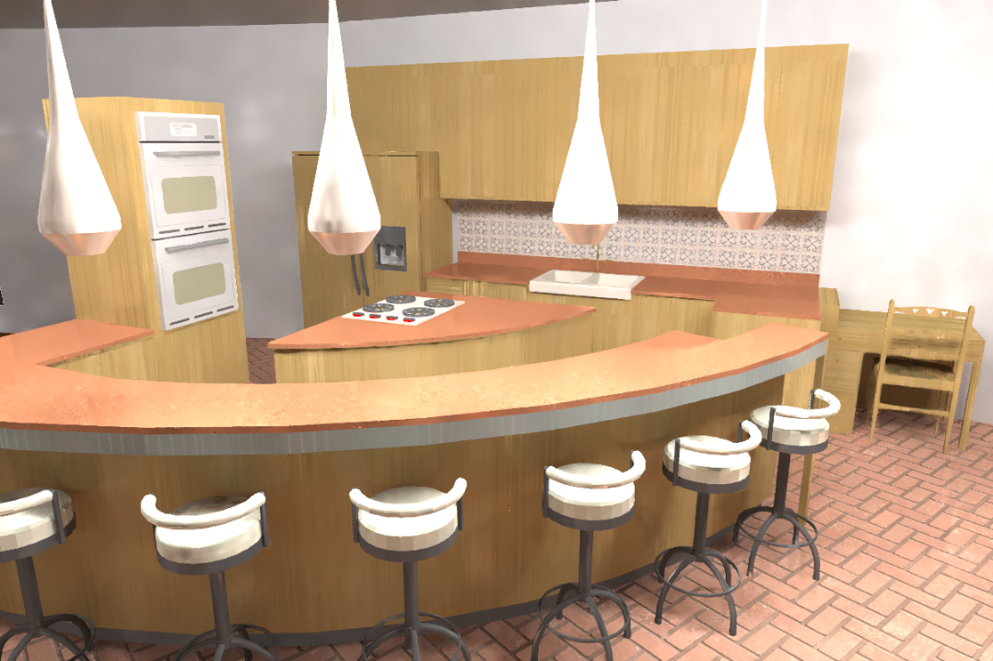

A Machine Learning Approach for
Filtering Monte Carlo Noise
Scene by Jo Ann Elliott

Slide 2

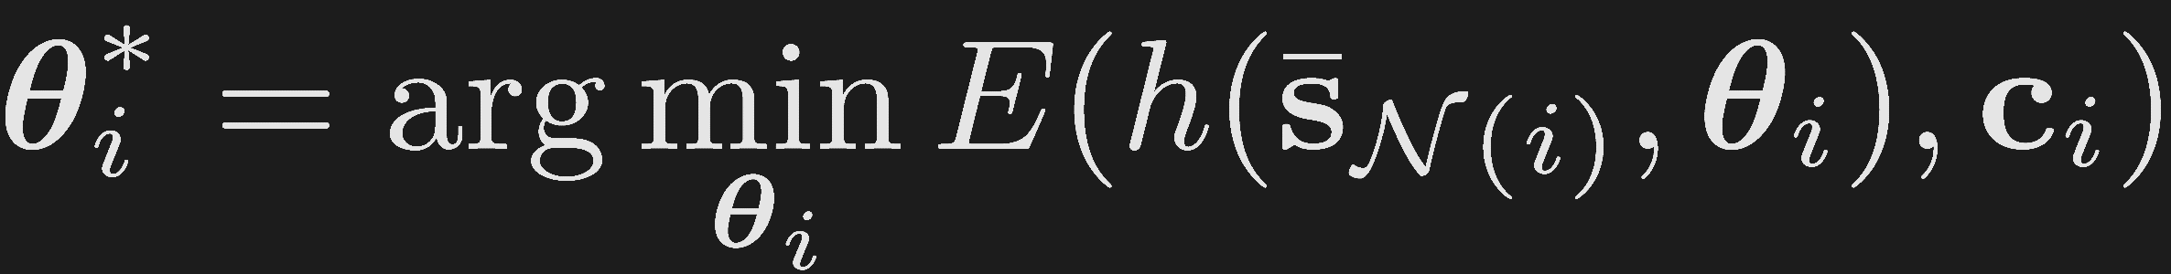










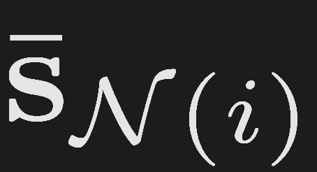

Previous work
Error-minimization
selected parameter
filtered
GT
ground
truth
…
filter
…
local primary
features
Rousselle et al. [2011] – Bias and variance
Li et al. [2012] – SURE
Rousselle et al. [2013] – SURE
Moon et al. [2014] – Bias and variance
Notes:
This gives us a new way of classifying the previous methods based on how they estimate the parameters.
Previous methods have proposed different no-reference metrics

Slide 3
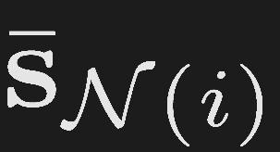

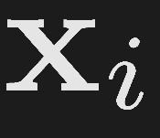

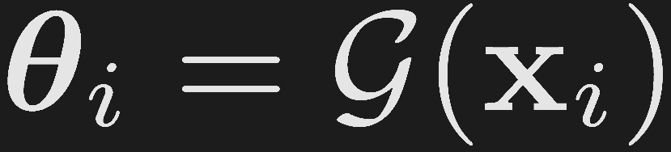
Previous work
Direct estimation
local primary
features
feature
extractor
secondary
features
filter
parameters
Sen and Darabi [2011] – Mutual information
Rousselle et al. [2012] – Dual buffer variances
Kalantari and Sen [2013] – MAD

Slide 4



Reflections on previous work
Error-minimization
  Minimize error, metric is noisy
  No , require running filter several times
Direct estimation
  No error minimization, no noisy error metric
  Heuristic , run the filter once
 | 1) Error min | 2) Direct est.
Minimizes error wrt. GT
Impacted by noisy error metric
Requires complex be defined
Runs filter multiple times
ü
û
û
ü
ü
û
û
ü
Notes:
Let’s compare these two approaches in terms of four main properties. The first class minimizes an error while the second class directly estimates the parameters and there is no guarantee for error minimization. On the other hand the first class requires an error estimate which could be noisy, however the second class doesn’t need any error metric. The first class doesn’t require to define G while the second class defines it heuristically. Finally to efficiently minimize the error the first class runs the filter multiple times but the second class directly estimate the parameters and thus runs the filter only once.

Slide 5
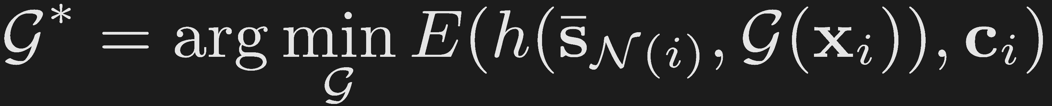
Our high-level idea
Direct estimation
Error-minimization
Combination
Key idea: perform process offline on a set of scenes
Notes:
So let’s present the high-level idea of our approach. First, we would like to directly estimate the per-pixel filter parameters like these kind of methods. But as we saw, these estimated parameters are not guaranteed to minimize the error with respect to the ground truth.
On the other hand, error minimization techniques attempt to minimize an error with respect to ground truth but have their own problems.
Our goal is to somehow combine these two approaches as shown here. Here, I simply replace theta I (the filter parameters) with the function G XI and so now our minimization is over G.
However, this simple combination still has the same problems as error minimization since we don’t have the GT and therefore we need to use error estimation metrics which can be noisy.
Our key idea is therefore to perform this process offline on a set of scenes during a training stage to find the optimal G. In that case, we would have all the ground truth images and we can use the actual error and we don’t have the problems of error-minimization techniques.

Slide 6


Our approach
Use supervised learning to estimate in a systematic way
Training stage
  Energy minimization on training set
  Benefits of error-minimization methods
Testing stage
  Use trained directly estimate
  Benefits of direct estimation techniques

Slide 7
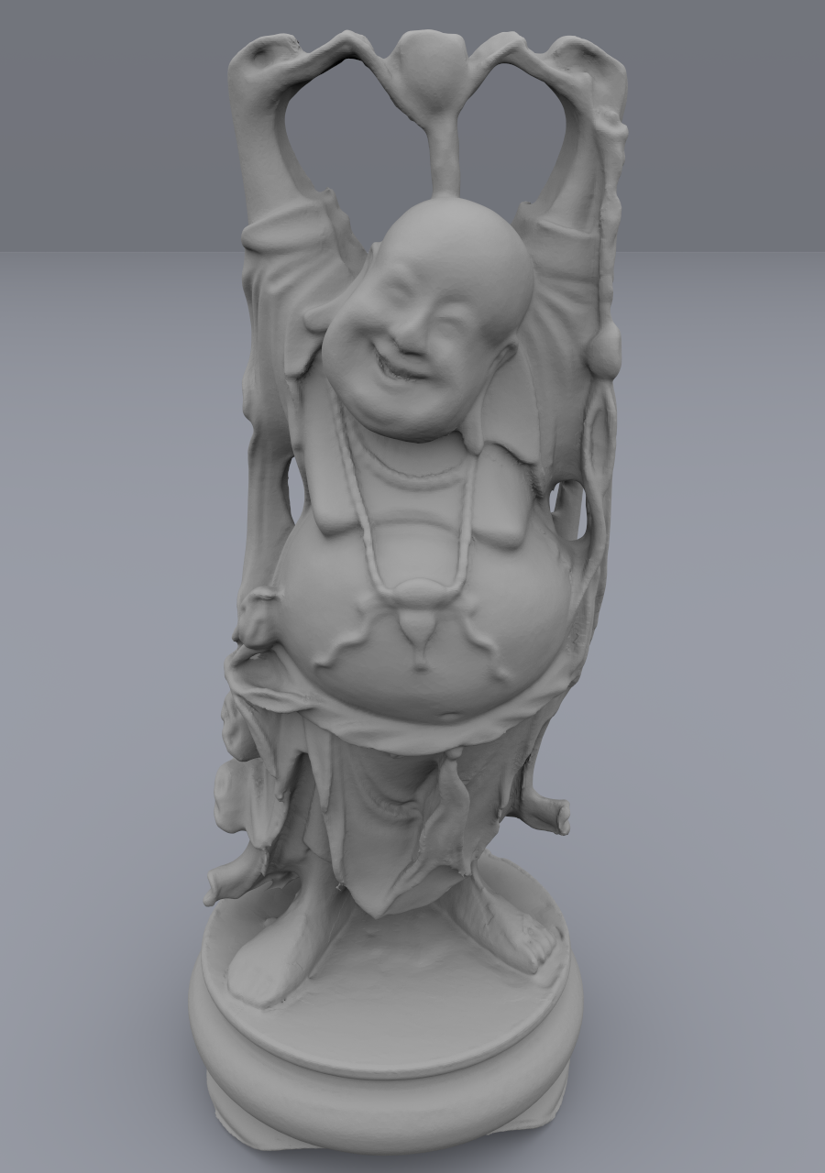

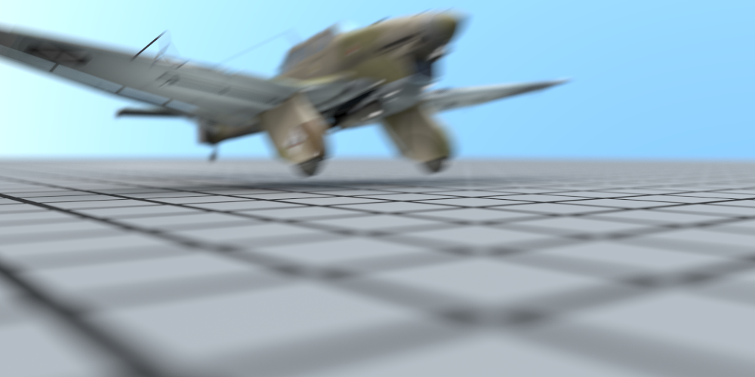
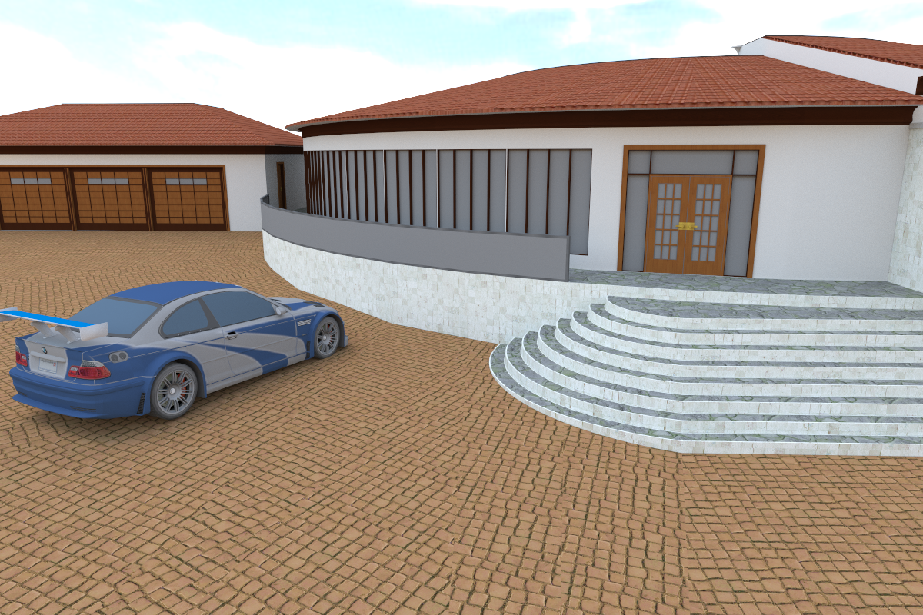
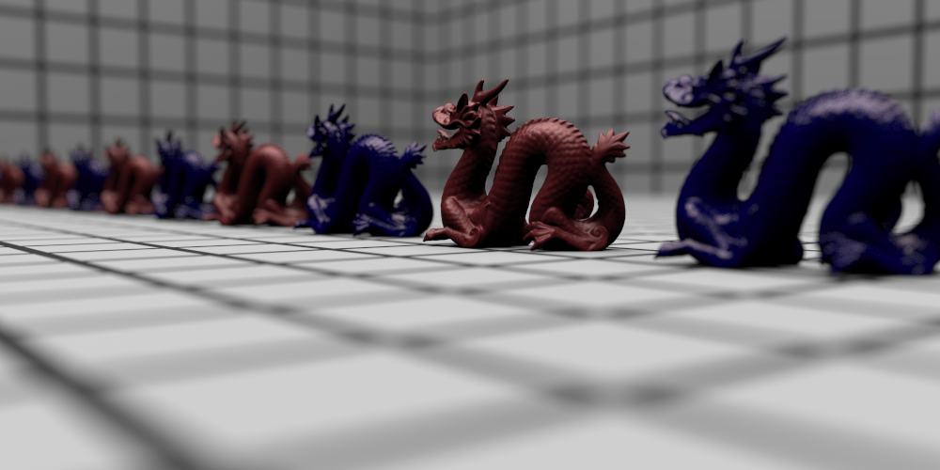
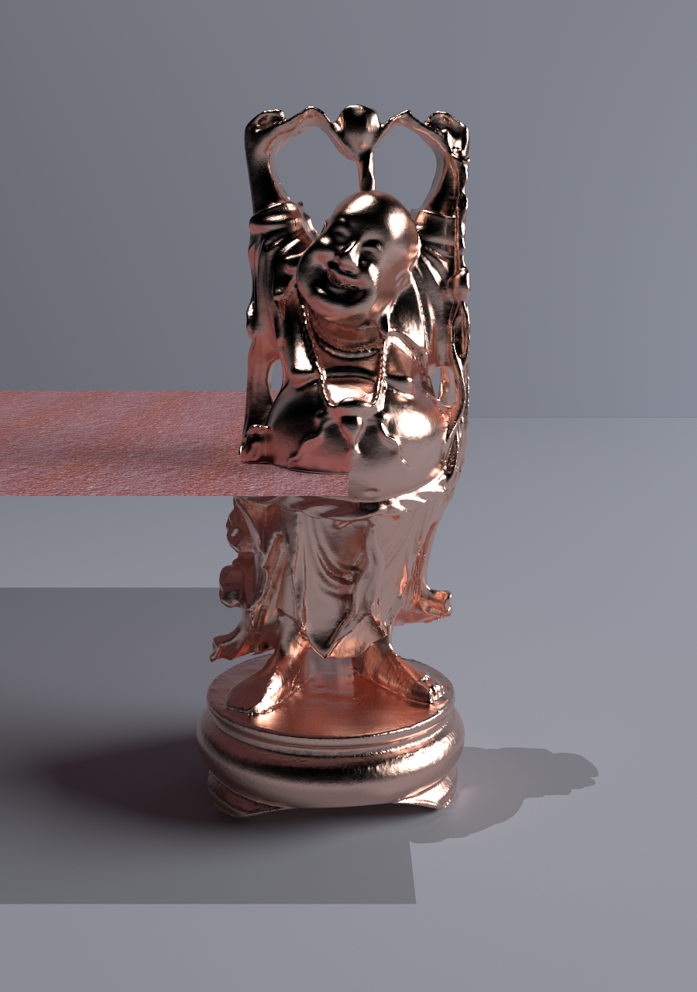

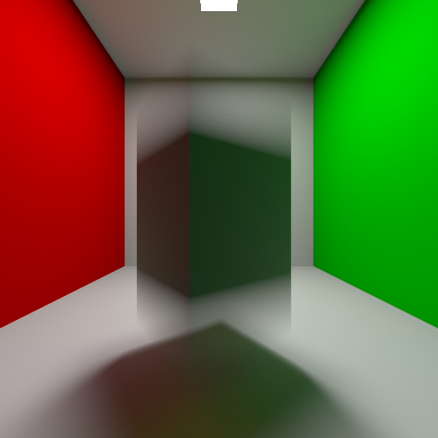

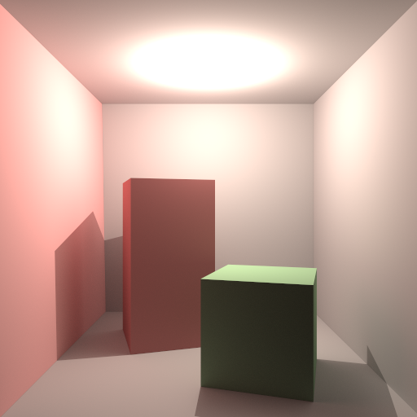
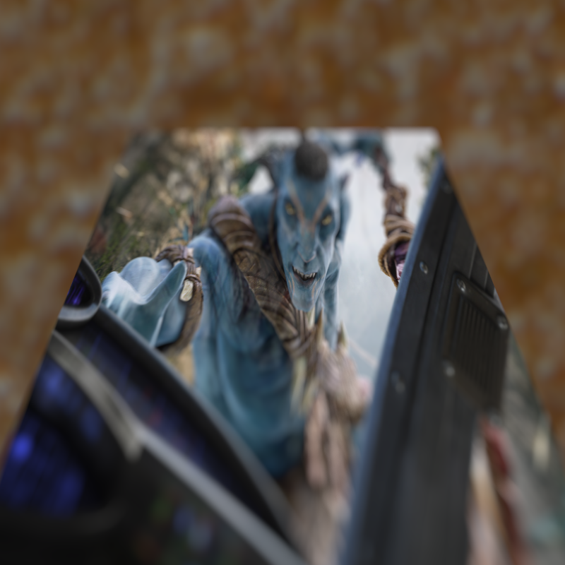
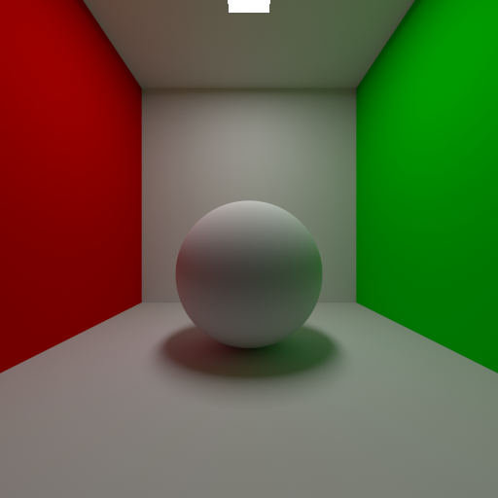
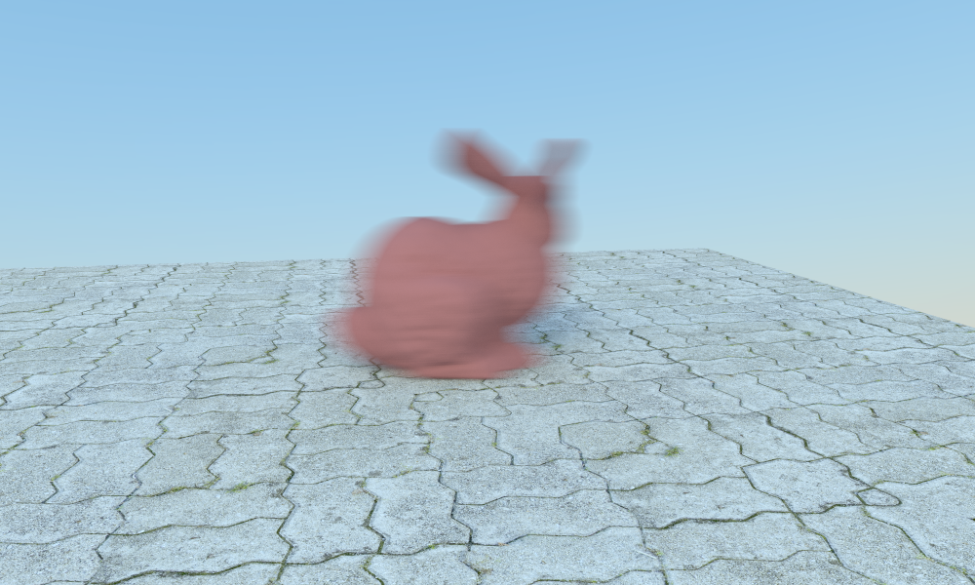
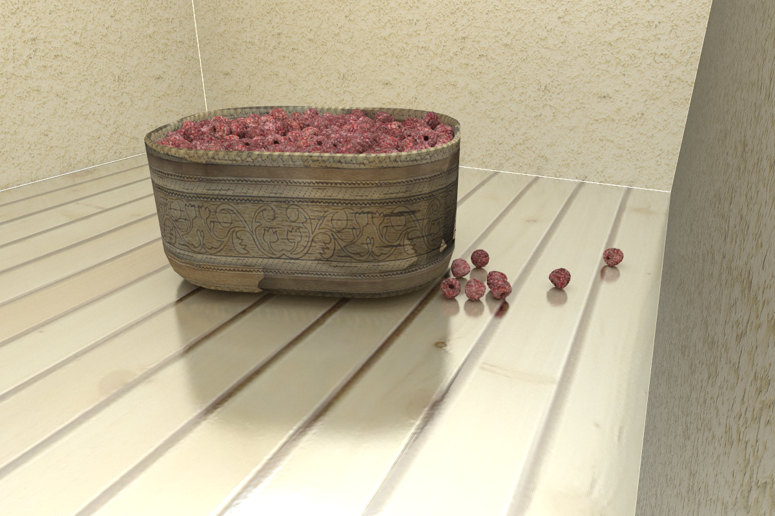
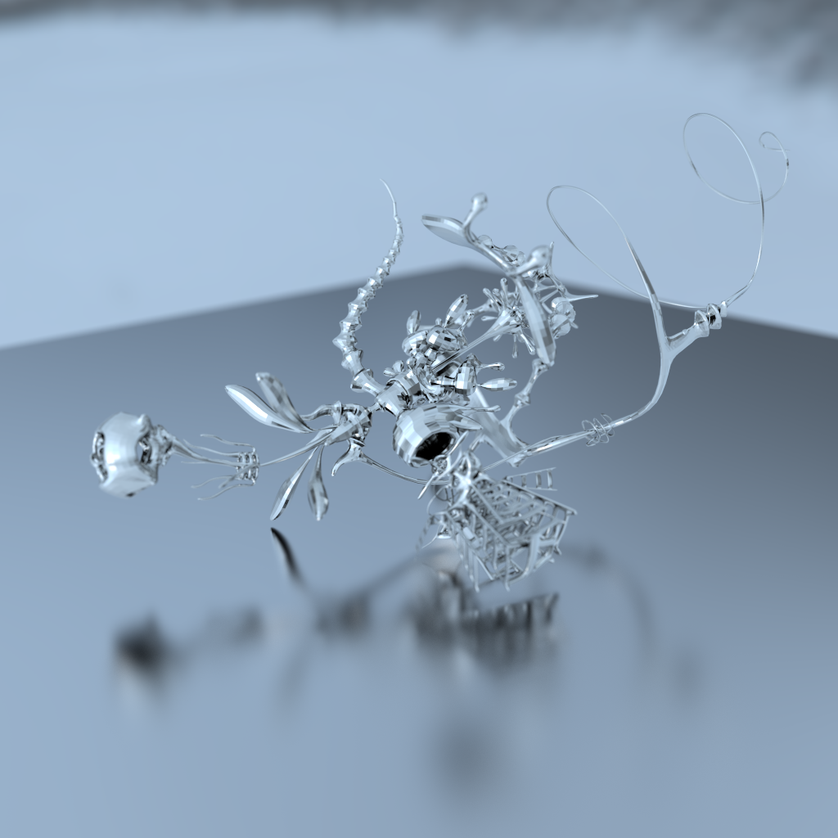
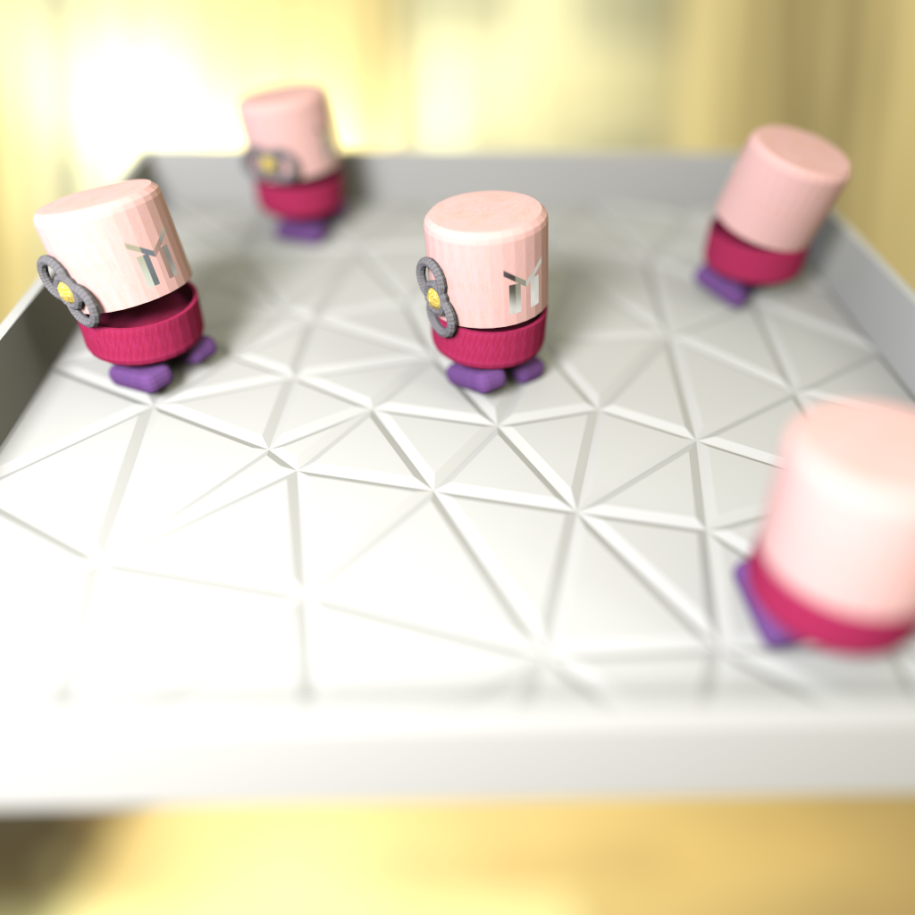
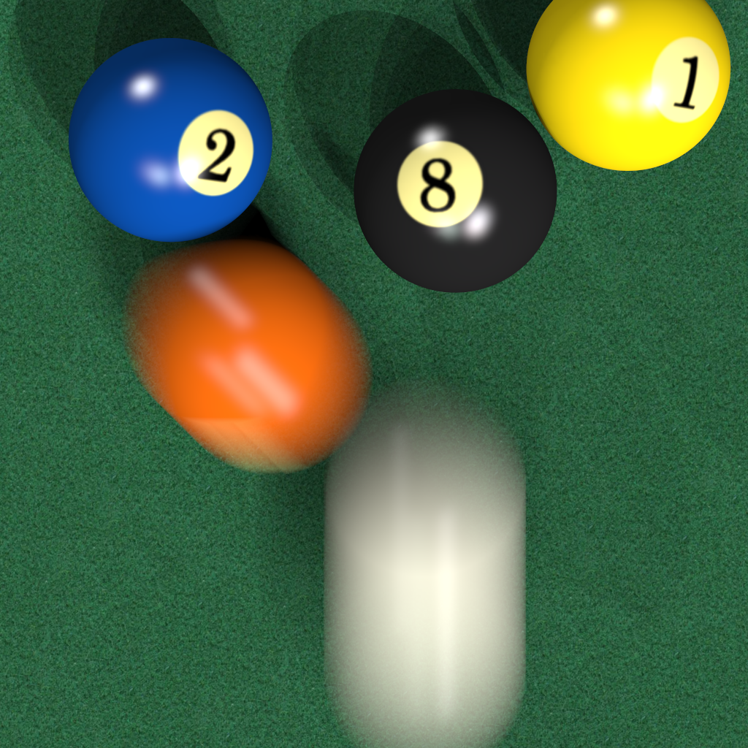

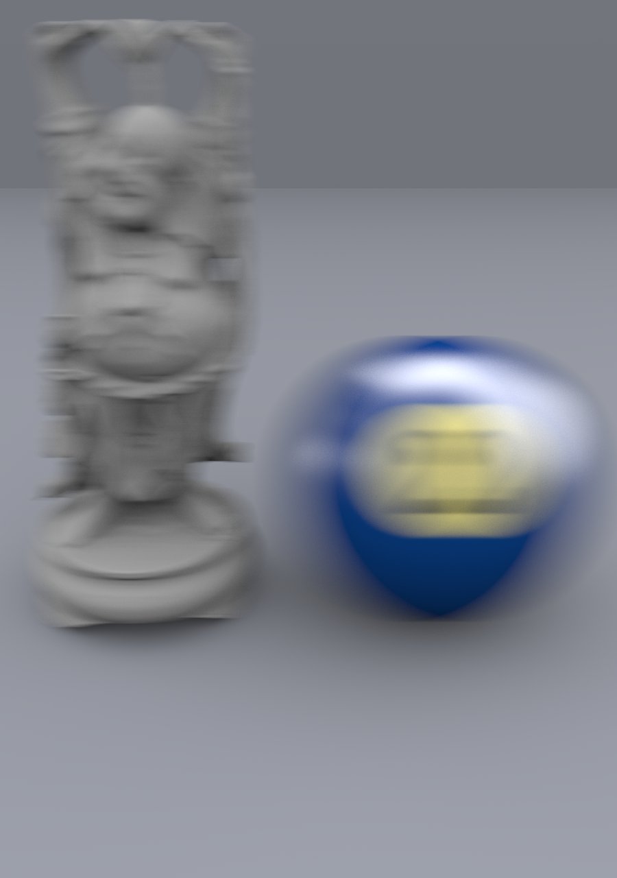
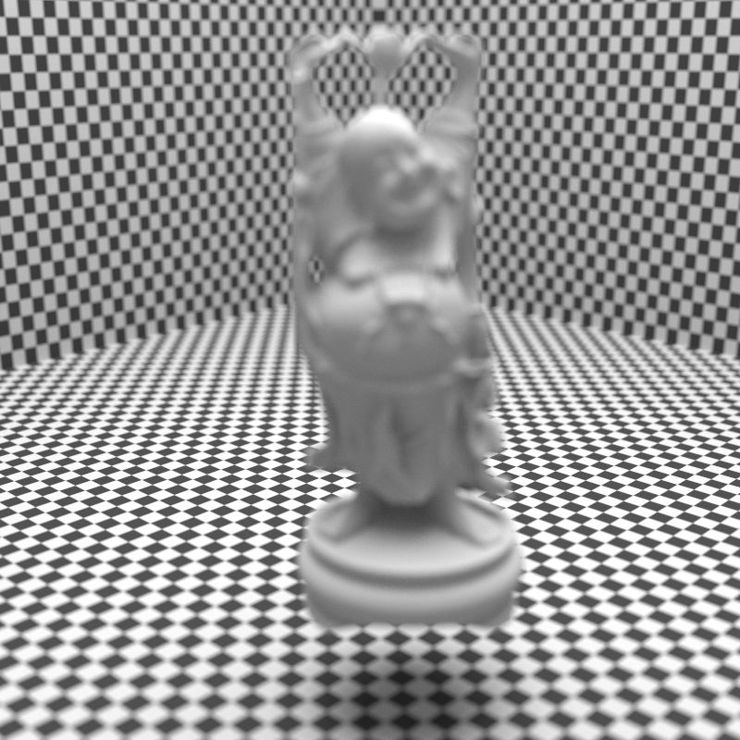
Training scenes
20 training scenes with variety of distributed effects, rendered at 4, 8, 16, 32, and 64

Slide 8

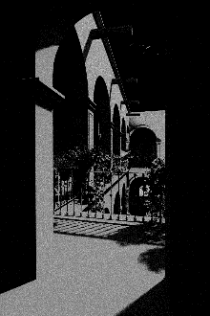


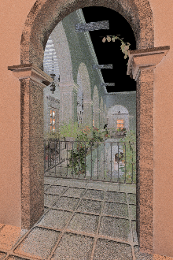
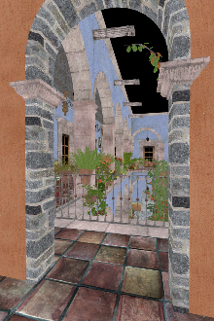

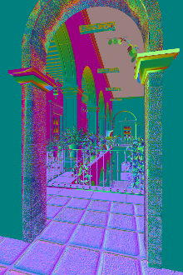


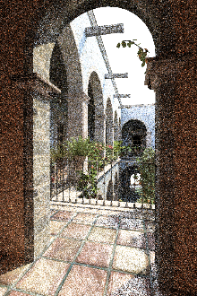




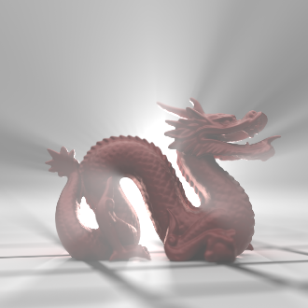

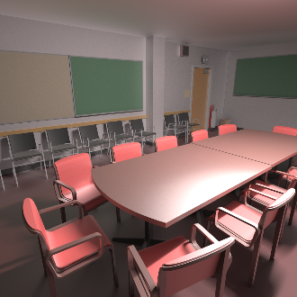
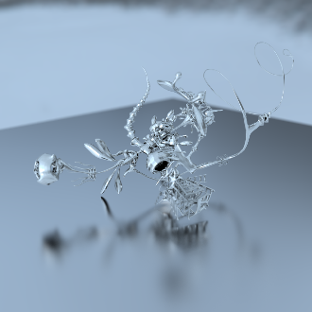

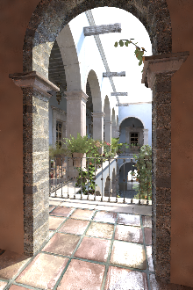

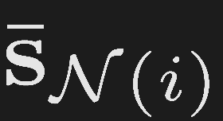
Training
estimated
primary
features
filter
parameters
filtered
pixel
GT
secondary
features
filtered
pixel
ground
truth
filter
…
…
local primary
features
scene primary
features
Courtesy of Stanford 3D Scanning Repository, Guedis Cardenas, Morgan McGuire, Anat Grynberg, Greg Ward, Keenan Crane, and Toshiya Hachisuka
Notes:
We have a set of scene primary features which have been computed by rendering the training scene with a small number of samples.
Compare it with the ground truth image which is rendered at a high sampling rate.

Slide 9

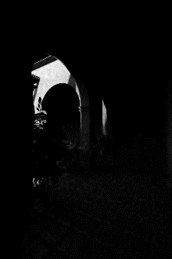
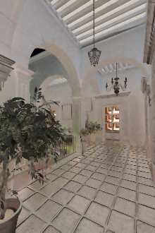
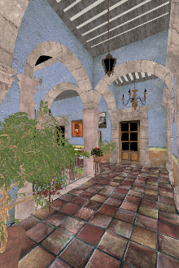
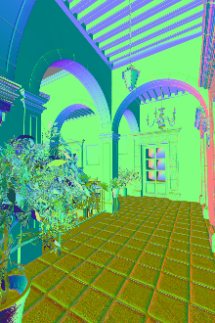



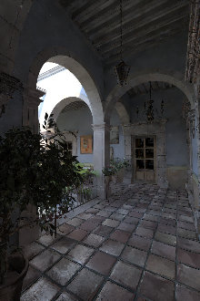
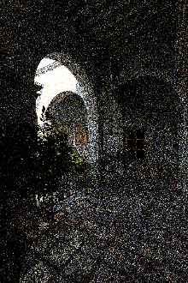







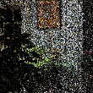


Testing
We use the estimated to filter new test scenes
secondary
features
filter
local primary
features
filtered
pixel
scene primary
features

Slide 10

Benefits of our approach
 | Error min | Direct est. | Ours
Minimizes error wrt. GT
Affected by noisy error metric
Requires complex be defined
Runs filter multiple times
ü
û
ü
û
ü
ü
ü
û
ü
û
ü
ü
Notes:
Let’s see the benefits of the new approach. First, we perform energy minimization wrt GT during training. As with any machine learning method, this will extend to the test scenes as long as the model has been properly trained
Let’s compare our approach to other techniques. We perform energy minimization during training. We do not need no-reference error estimation since we have access to the GT images during training. We define G but in a systematic way. We directly estimate filter parameters and thus need to run the filter only once.

Slide 11



Learning system
(neural networks)
Representation
Error metric
Optimization
(based on relative MSE)
(backpropagation)
secondary
features
filtered
pixel
ground
truth
filter
local primary
features
scene primary
features

Slide 12
Results

Slide 13

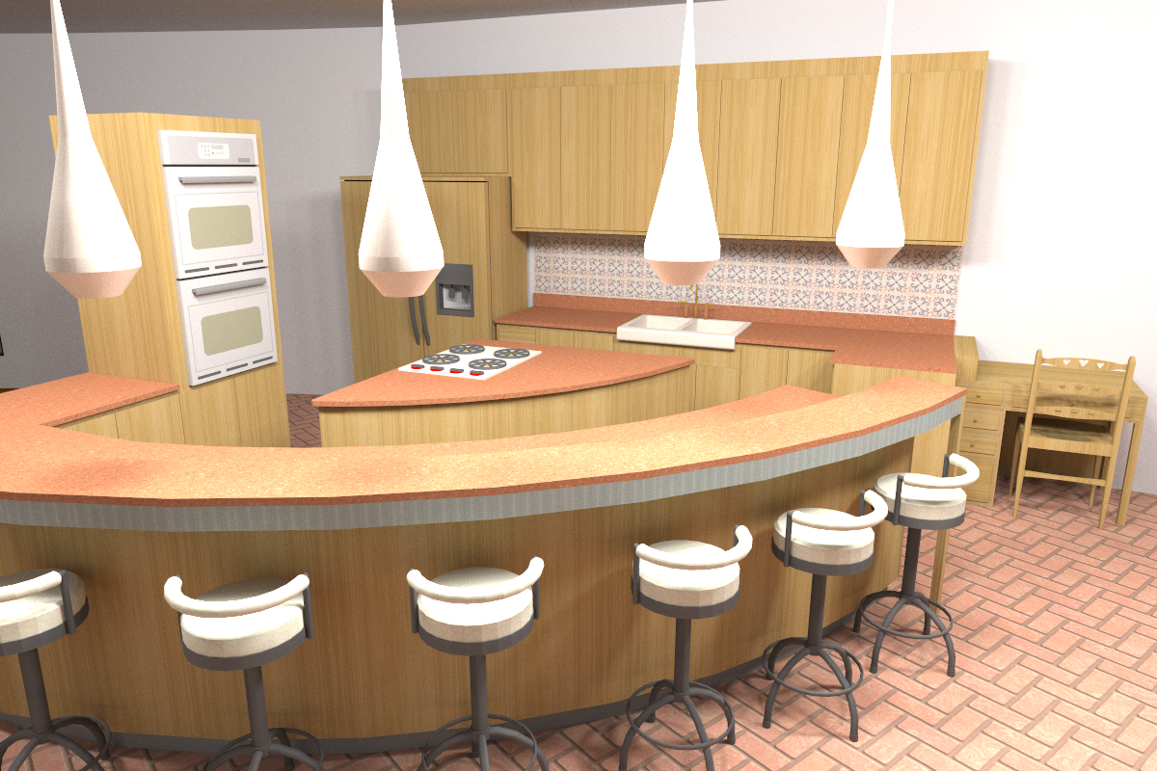

Kitchen (GI)
4 samples/pixel
32K samples/pixel
Our result
48.9 s
Ground truth
~ 3 days
Input MC
40.8 s
Scene by Jo Ann Elliott

Slide 14

Kitchen (GI)
4 samples/pixel
32K samples/pixel
Rousselle et al. 2013 (RD)
58.3 s
Ground truth
~ 3 days
Our result
48.9 s
Scene by Jo Ann Elliott

Slide 15
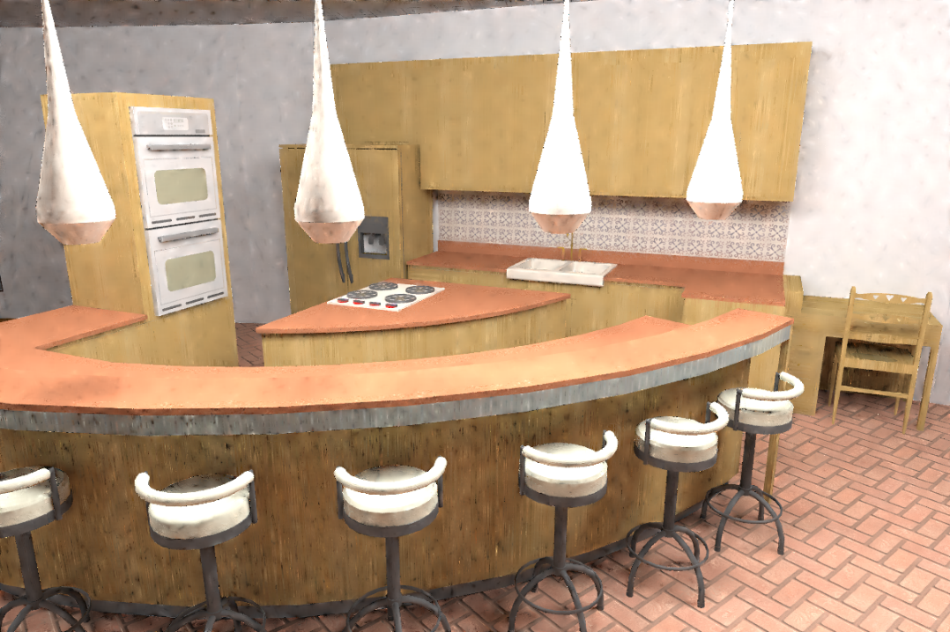
Kitchen (GI)
4 samples/pixel
32K samples/pixel
Moon et al. 2014 (WLR)
47.2 s
Ground truth
~ 3 days
Our result
48.9 s
Scene by Jo Ann Elliott

Slide 16
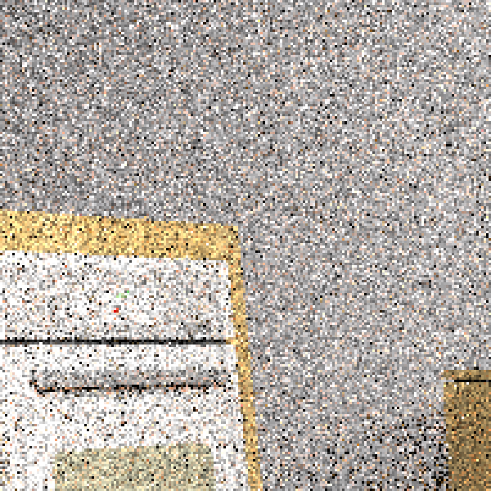
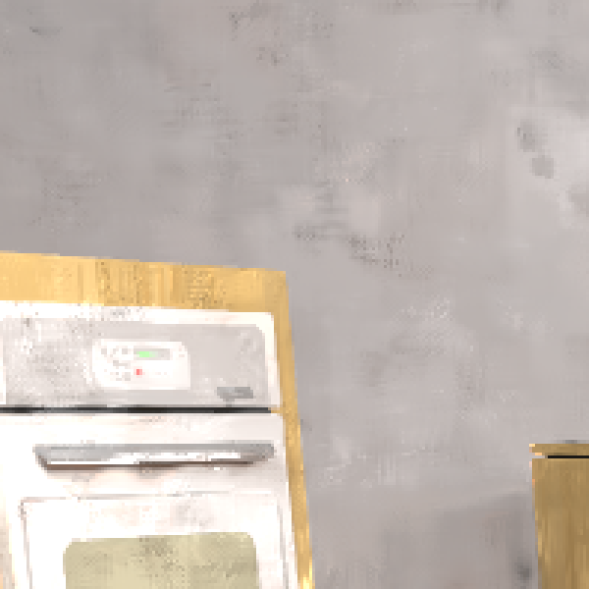
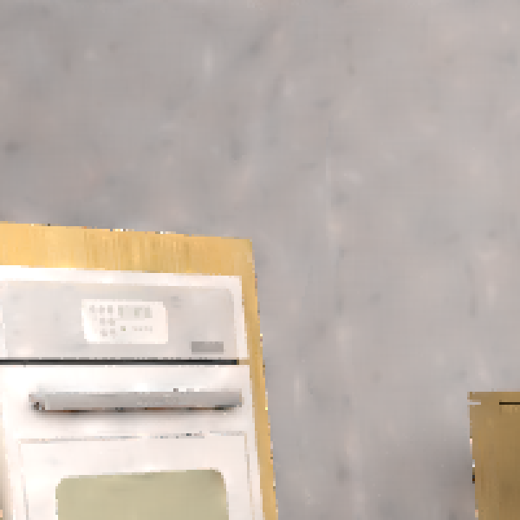






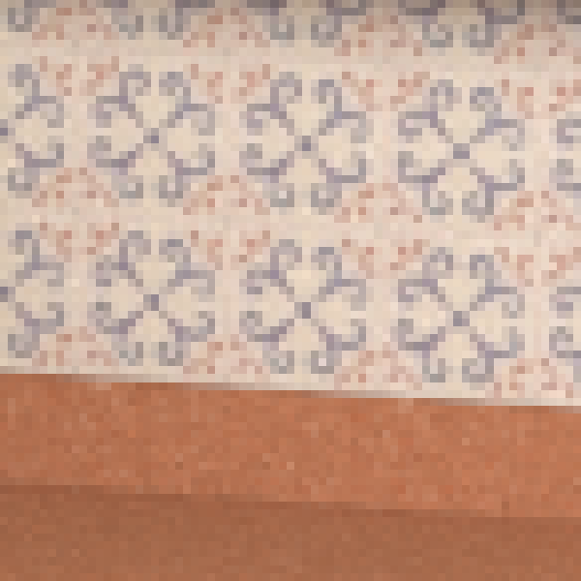
Kitchen (GI)
Input MC
RD
WLR
Ours
GT
40.8 s
776.48x10⁻²
0.540
58.3 s
4.71x10⁻²
0.895
47.2 s
2.76x10⁻²
0.906
48.9 s
2.05x10⁻²
0.939
Relative MSE
SSIM

Slide 17
Animated sequences

Slide 18
Kitchen

Slide 19
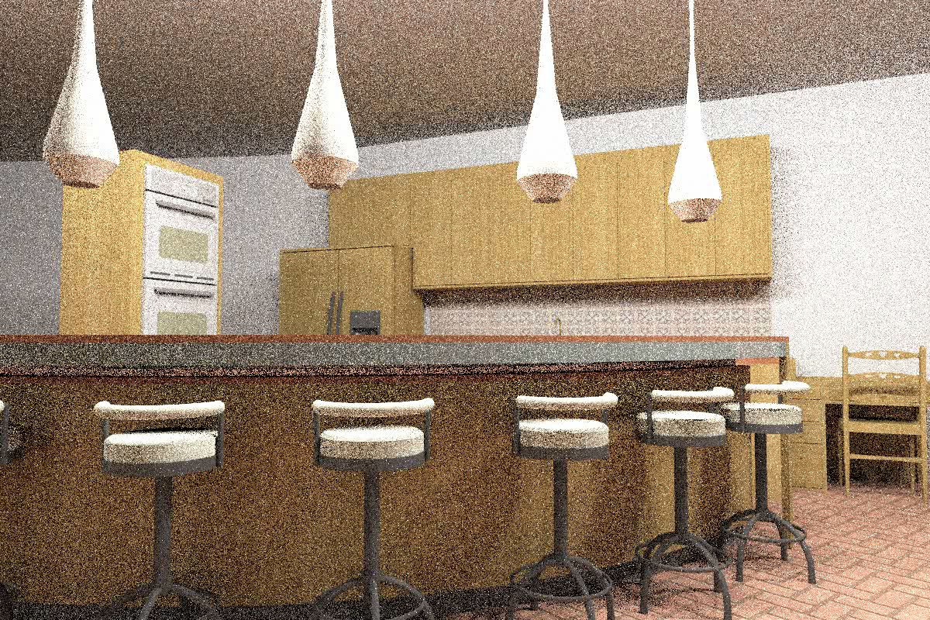
Input MC 8 spp - 80 sec/frame
Scene by Jo Ann Elliott

Slide 20
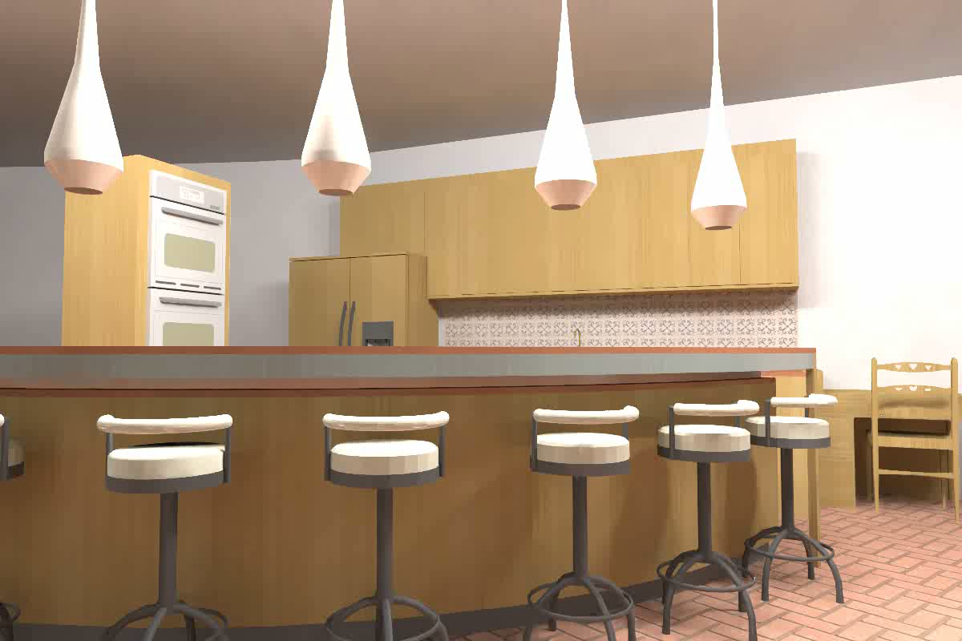
Our result 8 spp - 145 sec/frame
Scene by Jo Ann Elliott

Slide 21
Sci-fi City

Slide 22
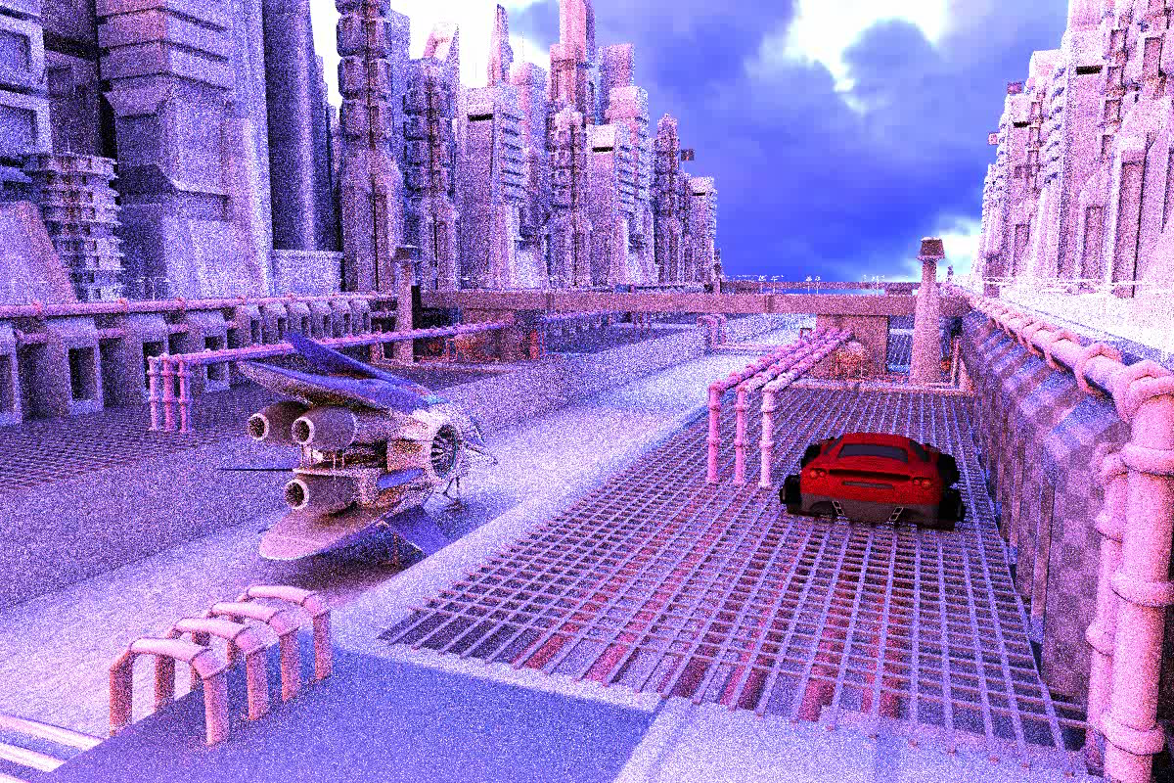
Input MC 16 spp - 70 sec/frame
Scene by Herminio Nieves and tf3dm.com user ysup12

Slide 23

Our result 16 spp - 135 sec/frame
Scene by Herminio Nieves and tf3dm.com user ysup12

Slide 24
The papers
N. K. Kalantari, S. Bako, and P. Sen, “A Machine Learning Approach for Filtering Monte Carlo Noise,” ACM Transactions on Graphics, Vol. 34, No. 4, July 2015 (Proceedings of SIGGRAPH 2015)

Slide 25

Source code available!
LBF code available here:
http://dx.doi.org/10.7919/F4CC0XM4

Slide 26

Acknowledgments
Various artists for the test scenes
Nvidia for the hardware donation of a GeForce GTX TITAN
Funding: National Science Foundation (IIS-1342931 and IIS-1321168)

